Slide 1

SAR ADC Implementation
Topic : Design and FGPA implementation of SAR ADC Digital logic and controller
Presented by
Jayant Punj (UE235057)
Shubham Singh(UEM235139)
Presented to
Prof. Arvind Kumar
Branch: B.E (ECE), 6th Semester

Slide 2
Introduction
What is an ADC?
An Analog-to-Digital Converter (ADC) is an electronic component that converts continuous, physical analog signals (like voltage, sound, or temperature) into discrete binary digital data that microprocessors can process.
◈
Flash
◈
Sigma-Delta
◈
SAR
◈
Pipelined
Very fast conversion High power consumption
High resolution High power at bandwidth
Power efficient Binary search algorithm
High throughput Very complex design
SAR ADC — FPGA Implementation | Jayant Punj & Shubham Singh
2

Slide 3
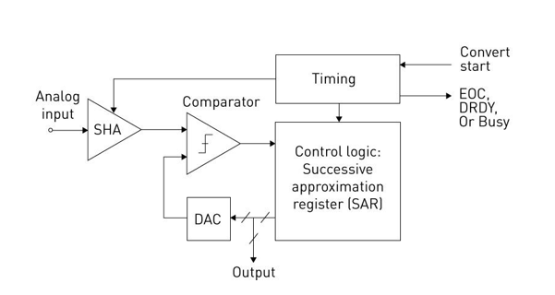
What is SAR ADC?
SAR ADC
A Successive Approximation Register (SAR) ADC is a type of analog-to digital converter that uses a binary search algorithm to convert continuous analog waveforms into discrete digital representations.
Flash ADC
Very fast but power hungry
Pipelined ADC
Very complex architecture
Sigma-Delta ADC
High power at higher bandwidth
3

Slide 4
Working Principle of SAR ADC
A Successive Approximation Register (SAR) ADC converts analog signals to digital by using a binary search algorithm to compare the input voltage against a DAC-generated voltage, one bit at a time, starting from the Most Significant Bit (MSB).
Step 1
Step 2
Step 3
Step 4
Step 5
Step 6
SAMPLE
▶
SET MSB
▶
COMPARE
▶
DECIDE
▶
SHIFT
▶
OUTPUT
Capture analog input voltage
Set the most significant bit to 1
Compare Vin vs DAC output
Keep or reset bit based on result
Move to next lower bit
After N cycles, digital result is ready
4

Slide 5
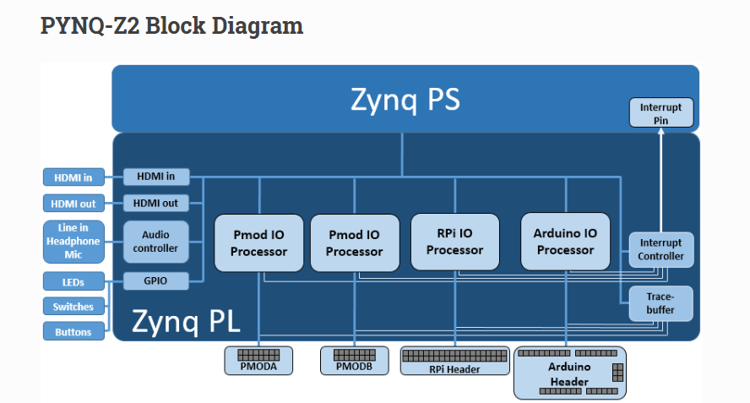
Project Objective
In this project, we design and implement the digital logic and controller of a SAR ADC using Verilog on a
PYNQ-Z2 FPGA.
5

Slide 6
Project Scope
We are not building an ADC physically, rather we are implementing it on a FPGA board with its SAR control logic, bit decision FSM, DAC control signals and timing control all done in the FPGA.
This means that comparator will be stimulated, the DAC will be modelled digitally and our SAR logic will be Verilog design
6

Slide 7
Target Platform
Zynq-7000 SoC
XADC (Built-in ADC)
Programmable Logic
Verilog HDL
▸ Industry-grade SoC
▸ Dual-core ARM Cortex-A9
▸ Reprogrammable logic fabric
▸ Integrated analog front end
▸ Supports real input testing
▸ FPGA fabric for custom logic
▸ ARM processor co-design
▸ High-speed I/O support
▸ Hardware description language
▸ Synchronous design style
▸ Vivado synthesis tool
7

Slide 8
Implementation Methodology
The SAR ADC digital logic is implemented on FPGA using Verilog HDL. The design follows a modular architecture consisting of:
1.
SAR Controller - FSM based sequencing and control
2. SAR Register – Bit by bit storage of converted result
3. Comparator logic - digital model
4. DAC Model – digital approximation of voltage output
The conversion process is performed iteratively using a binary search algorithm.
8

Slide 9
System Architecture
The system consists of the following blocks:
SAR Controller: Controls conversion sequence
SAR Register: Stores intermediate and final digital output
DAC Model: Generates reference voltage from digital code
Comparator: Compares input with DAC output
The controller updates one bit per clock cycle.
9

Slide 10
Successive Approximation Algorithm
The SAR ADC performs conversion using a binary search approach:
1.
Set MSB to 1
2.
Compare input with DAC output
3.
Keep or reset bit based on comparison
4.
Move to next bit
5.
Repeat until LSB
Total conversion time = N clock cycles (for N-bit ADC)
10

Slide 11
FSM-Based Control Logic
The SAR logic is implemented as a finite state machine with the following states:
IDLE
Wait for start signal
UPDATE
Modify bit value
SAMPLE
Capture input
NEXT
Move to next bit
SET_BIT
Set current bit to 1
DONE
Output final result
COMPARE
Perform comparison
11

Slide 12
Verilog Implementation
The SAR controller is implemented using synchronous Verilog design:
Clock-driven sequential logic
Bit-by-bit update using shift/index control
Comparator implemented using digital comparison
DAC Modeled as scaled digital value
The design ensures deterministic timing and hardware efficiency.
12

Slide 13
FPGA Implementation & Validation
The design is synthesized and implemented using Vivado on the PYNQ-Z2 FPGA. Simulation is performed to verify:
◈
Bit-by-bit Convergence
◈
Correct Final Output
Each bit is resolved correctly in sequence, from MSB to LSB
Digital output matches expected value for given analog input
◈
Timing Verification
Conversion completes in exactly N clock cycles per sample
Optional integration with XADC allows real input testing
13

Slide 14
Motive & Applications
SAR ADC is widely used in:
IoT devices
Biomedical systems
Embedded systems
FPGA implementation allows:
Flexibility
Prototyping
Hardware Acceleration
14

Slide 15
Advantages of Our Approach
Low Power
Compared to flash ADC architecture, SAR consumes significantly less power
Scalable Resolution
N-bit resolution easily adjusted by modifying bit count in Verilog
Digital Control
Fully digital controller is easy to debug, modify, and extend
FPGA-Based
Rapid prototyping and real-time testing without physical ADC hardware
15

Slide 16
Future Scope
01
SAR-Assisted Pipeline ADC : Combine SAR with pipelining for higher throughput and speed
02
RISC-Assisted SAR ADC : Integrate a RISC-V soft processor to dynamically control SAR conversion and calibrate in real time
THANK YOU
16

